Slide 1
Lecture 02: KNN & Confusion Matrix

Slide 2
Contents
kNN classifier
Confusion Matrix
Conclusions

Slide 3
Types of Machine Learning
Machine Learning
Supervised
Unsupervised
Reinforcement

Slide 4
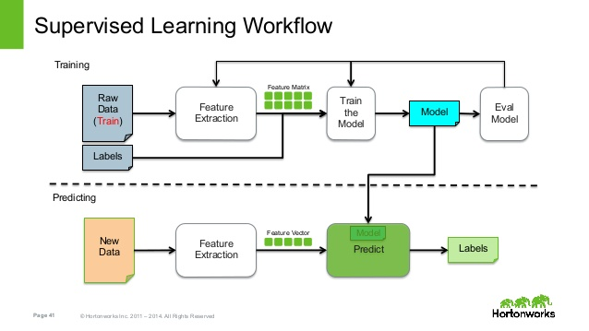
Notes:
Machine Learning method able to extract rules from this data

Slide 5
Instance Based Classifiers
First Example of Supervised Classification
Examples:
Rote-learner
Memorizes entire training data and performs classification only if attributes of record match one of the training examples exactly
Nearest neighbor
Uses k “closest” points (nearest neighbors) for performing classification

Slide 6
Introduction to KNN
KNN is a lazy learner i.e. generalization is achieved until query is made to the system.
Usually used for classification problem, but it can also be used for regression.
Non-parametric
Non-linear decision boundaries

Slide 7
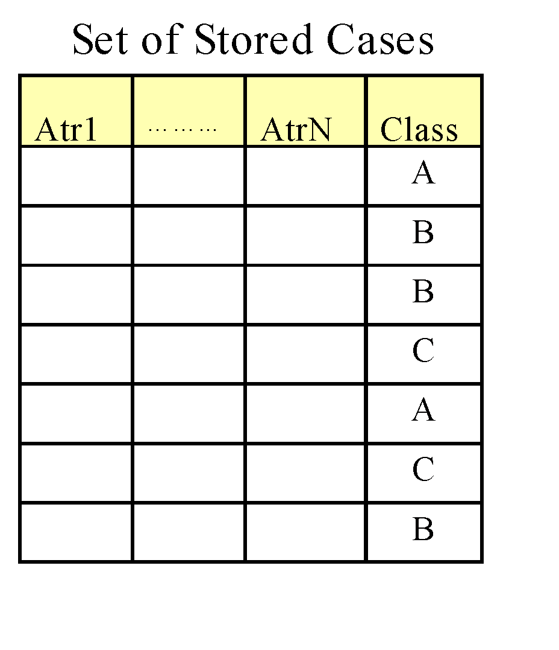
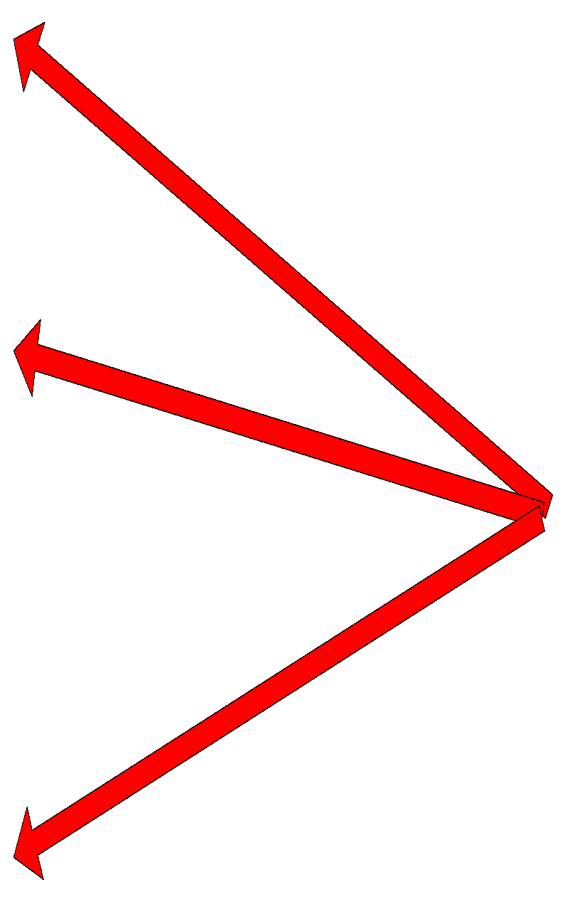
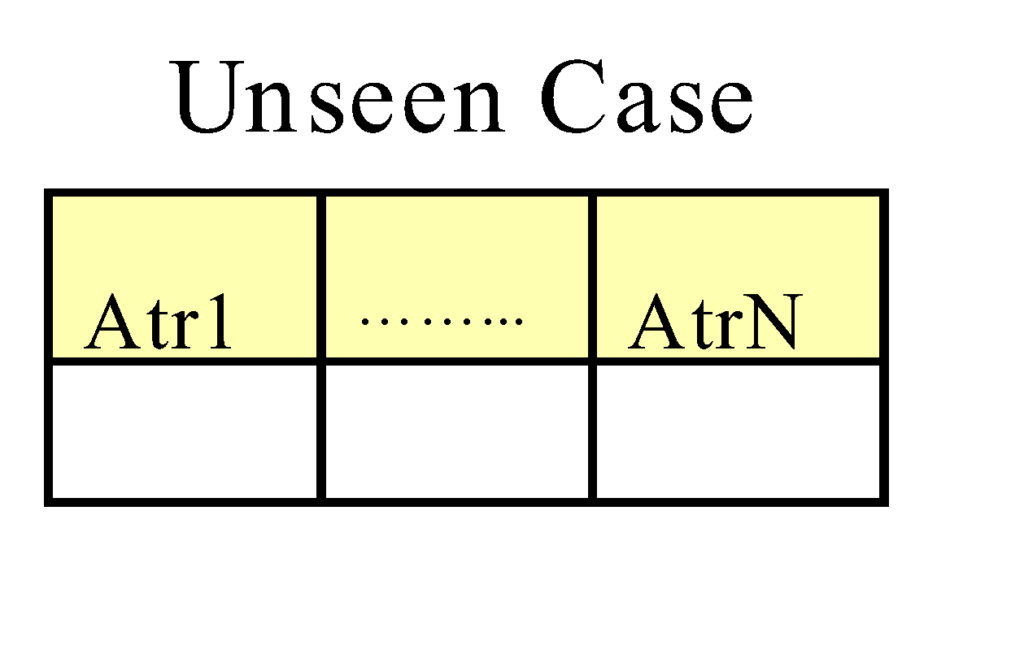
Instance-Based Classifiers
Store the training records
Use training records to predict the class label of unseen cases

Slide 8
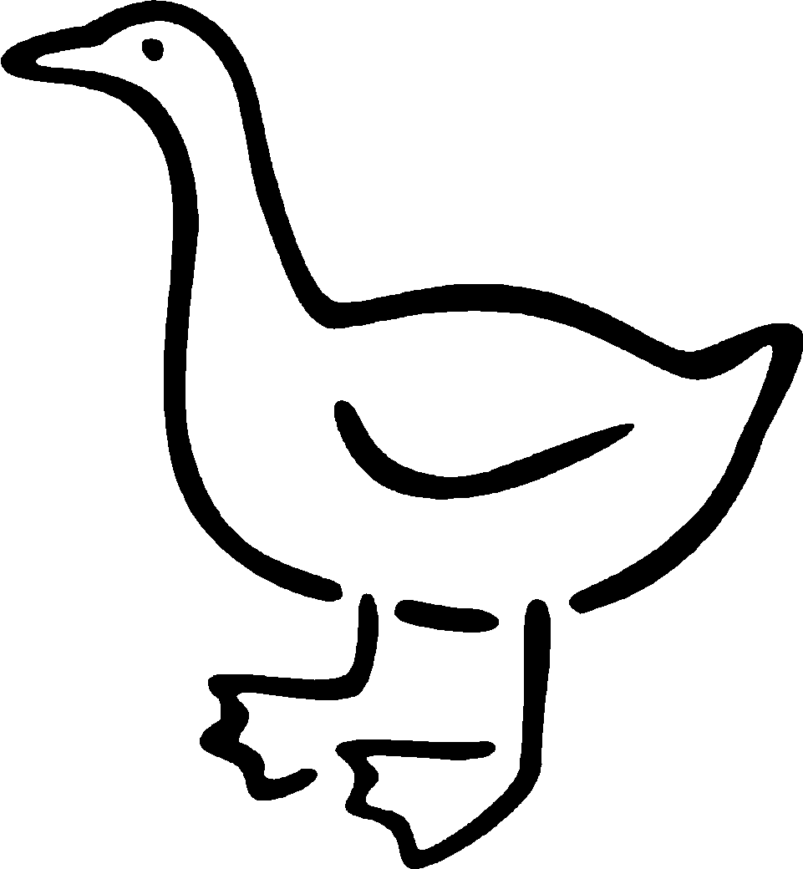
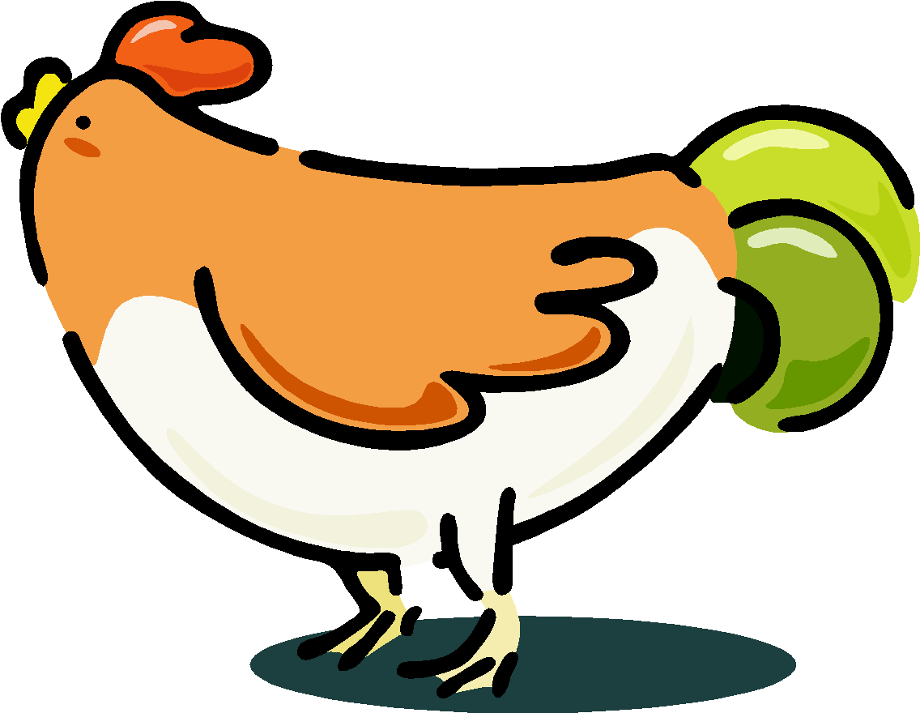


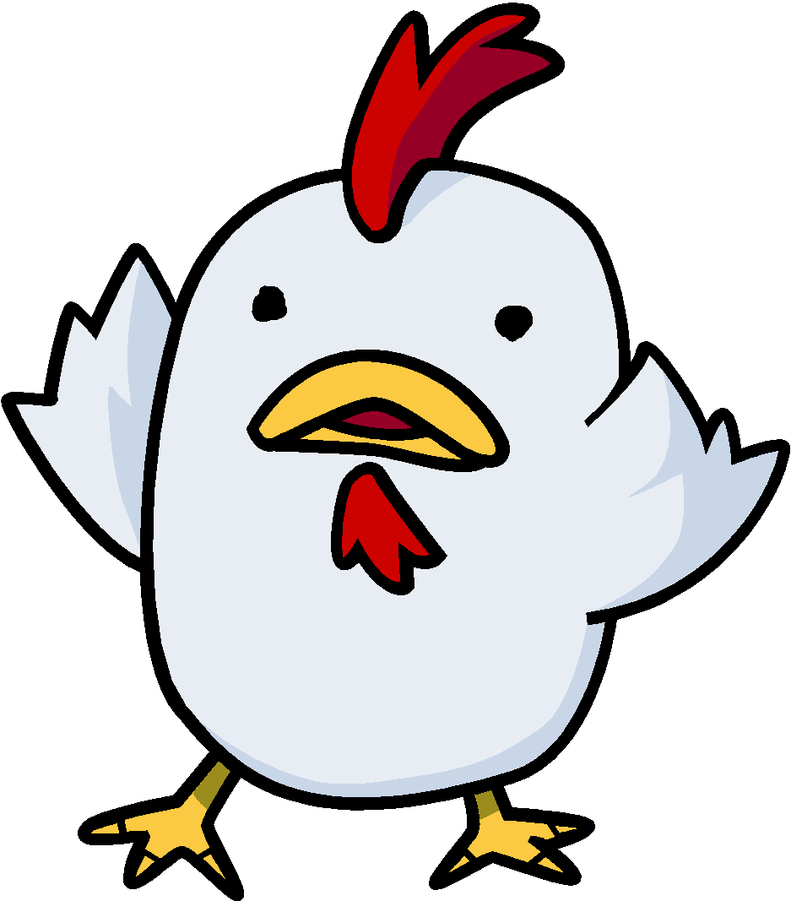

Nearest Neighbor Classifiers
Basic idea:
If it walks like a duck, quacks like a duck, then it’s probably a duck
Compute Distance
Test Record
Choose k of the “nearest” records
Training Records

Slide 9
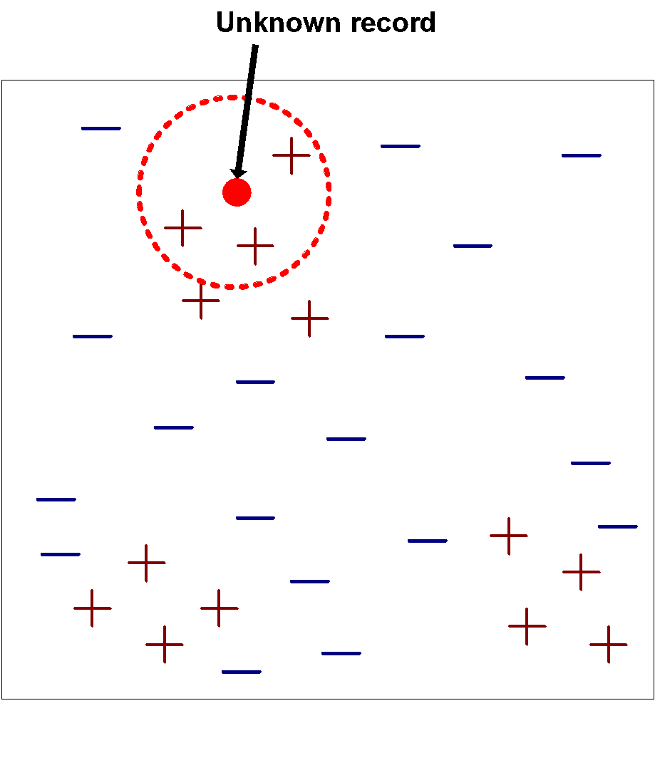
Nearest-Neighbor Classifiers
Requires three things
The set of stored records
Distance Metric to compute distance between records
The value of k, the number of nearest neighbors to retrieve
To classify an unknown record:
Compute distance to other training records
Identify k nearest neighbors
Use class labels of nearest neighbors to determine the class label of unknown record (e.g., by taking majority vote)

Slide 10
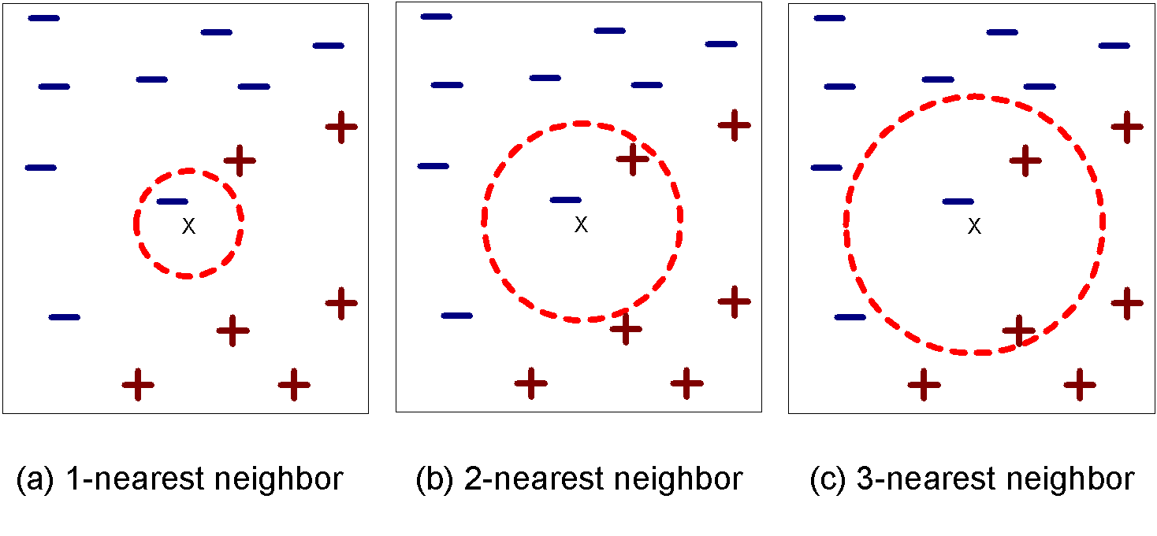
Definition of Nearest Neighbor
K-nearest neighbors of a record x are data points that have the k smallest distance to x

Slide 11
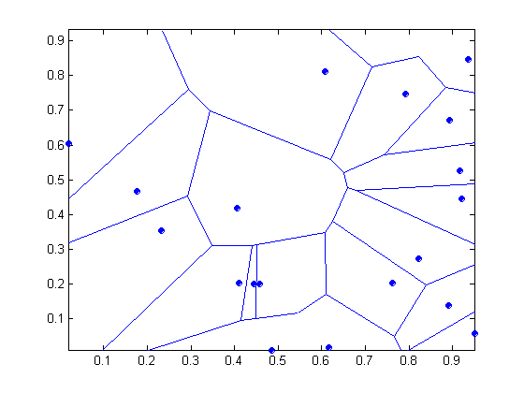
1 nearest-neighbor
Voronoi Diagram

Slide 12
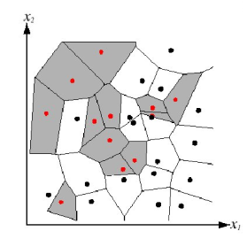
Nearest Neighbors: Decision Boundaries
Nearest neighbor algorithm does not explicitly compute decision boundaries, but these can be inferred
Decision boundaries: Voronoi diagram visualization
show how input space divided into classes
each line segment is equidistant between two points of opposite classes

Slide 13
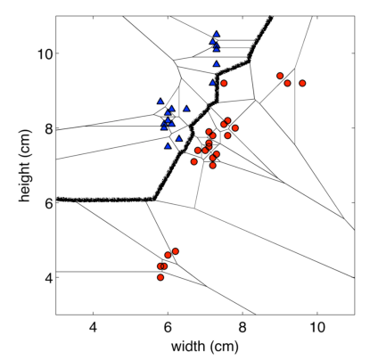
Example: 2D decision boundary

Slide 14
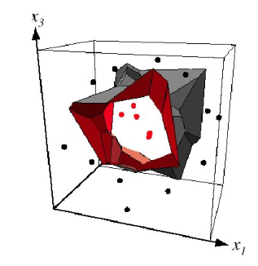
Example: 3D decision boundary

Slide 15
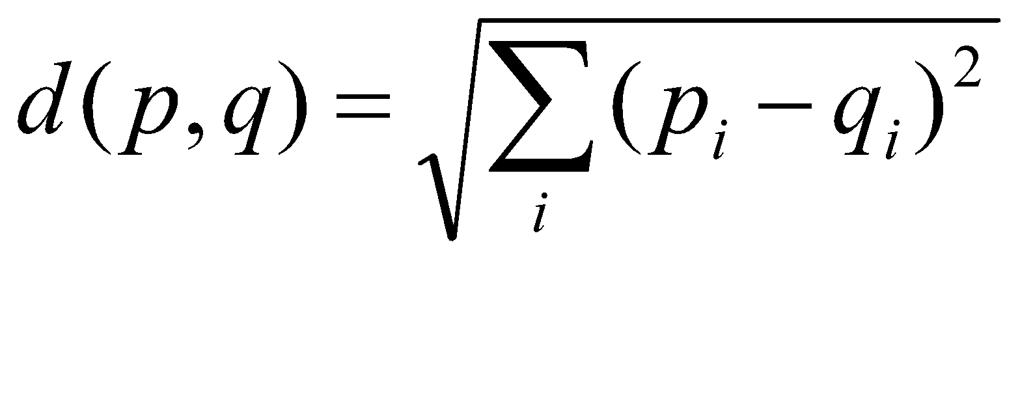
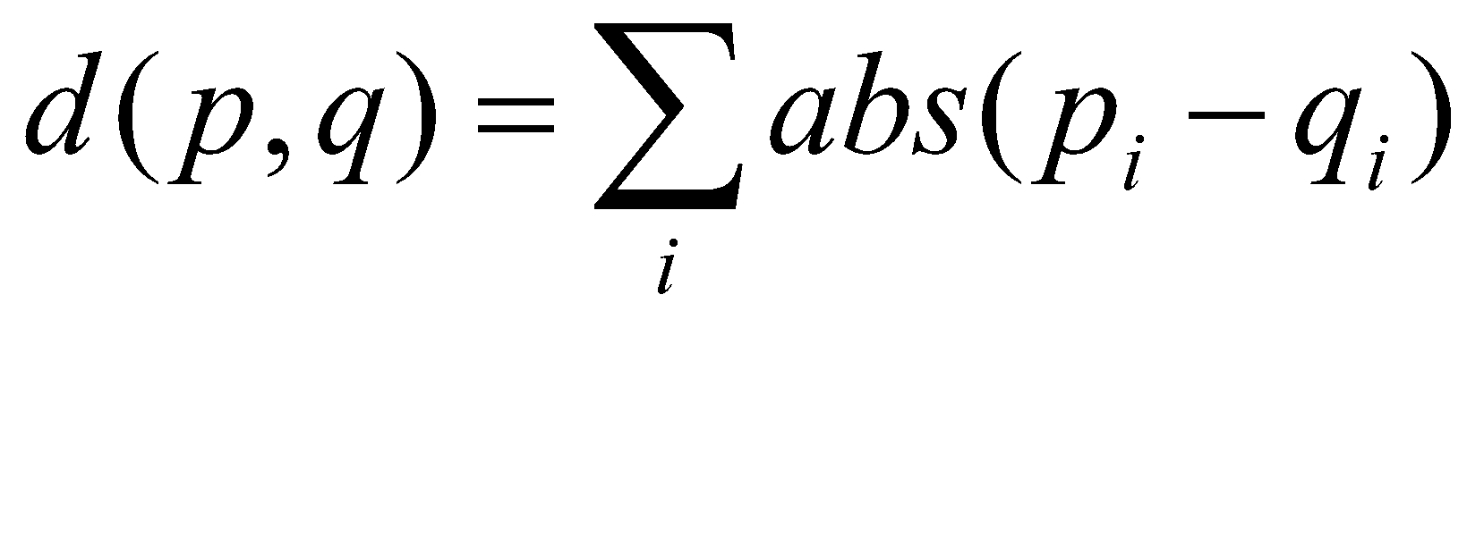
Nearest Neighbor Classification
Compute distance between two points:
Euclidean distance
Determine the class from nearest neighbor list
take the majority vote of class labels among the k-nearest neighbors
Weigh the vote according to distance
weight factor, w = 1/d²

Slide 16
Example (NN Classifier)
F1 | F2 | Class
1 | 5 | 0
0 | 8 | 0
0 | 6 | 1
1 | 2 | 1
Training Data
1 | 3 | ?
1 | 4 | ?
0 | 3 | ?
0 | 4 | ?
Test Data

Slide 17
Example (NN Classifier)
Step 1: Computer Distance from Test Sample 1 to Training Data
Step 2:
Step 3: Assign the Test Sample to Class with minimum Distance, Here is Class 1. So Test Sample 1 belongs to Class 1
Distance from Test Sample 1 to All Training Samples |  | Class
1 | |1-1|+|3-5| = 0 + 2 = 2 | 0
2 | |1-0|+|3-8| = 1 + 5 = 6 | 0
3 | |1-0|+|3-6| = 1 + 3 = 4 | 1
4 | |1-1|+|3-2| = 0 + 1 = 1 | 1

Slide 18
Example (NN Classifier)
Exercise: Calculate for other 3 Test Samples
ID | Actual | Predicted
1 | 0 | 1
2 | 0 | 0
3 | 1 | 1
4 | 1 | 0 or 1

Slide 19
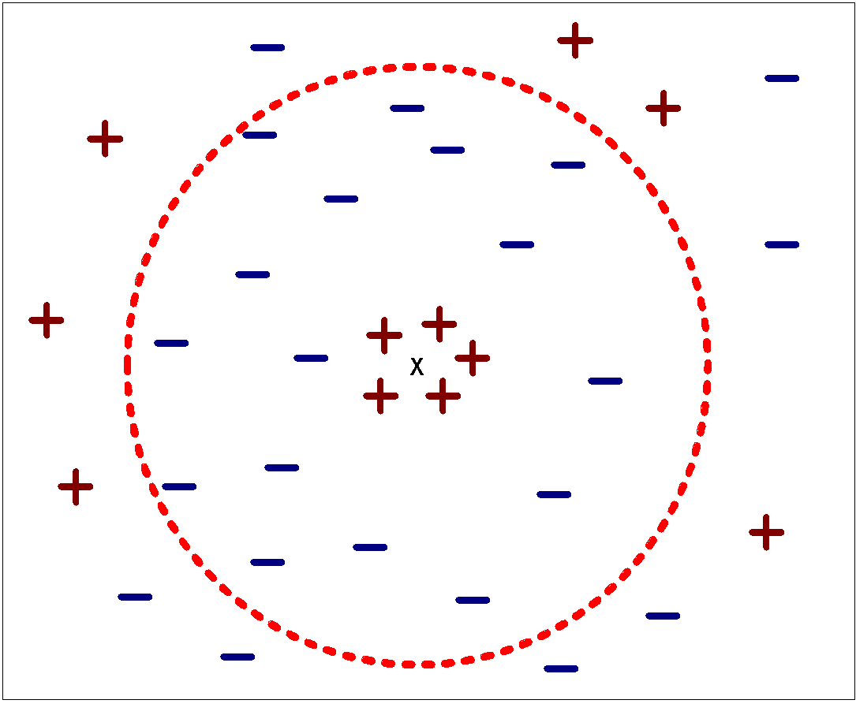
Nearest Neighbor Classification…
Choosing the value of k:
If k is too small, sensitive to noise points
If k is too large, neighborhood may include points from other classes
We can use cross-validation to find k
Rule of thumb is k < sqrt(n), where
n is the number of training examples

Slide 20
Nearest Neighbor Classification…
Scaling issues
Attributes may have to be scaled to prevent distance measures from being dominated by one of the attributes
Example:
height of a person may vary from 1.5m to 1.8m
weight of a person may vary from 90lb to 300lb
income of a person may vary from $10K to $1M

Slide 21
Example (NN Classifier)
Normalize Data from 0 to 1
F1 | F2 | Class
1 | 0.5 | 0
0 | 1 | 0
0 | 0.667 | 1
1 | 0 | 1
Training Data
1 | 0.167 | ?
1 | 0.334 | ?
0 | 0.167 | ?
0 | 0.334 | ?
Test Data

Slide 22
Example (NN Classifier)
After Normalization
ID | Actual | Predicted
1 | 0 | 1
2 | 0 | 0
3 | 1 | 1
4 | 1 | 1

Slide 23
k-Nearest Neighbors: Issues (Complexity) & Remedies
Expensive at test time: To find one nearest neighbor of a query point x, we must compute the distance to all N training examples. Complexity: O(kdN) for kNN
Use subset of dimensions
Pre-sort training examples into fast data structures (e.g., kd-trees)
Compute only an approximate distance (e.g., LSH)
Remove redundant data (e.g., condensing)
Storage Requirements: Must store all training data
Remove redundant data (e.g., condensing)
Pre-sorting often increases the storage requirements
High Dimensional Data: “Curse of Dimensionality”
Required amount of training data increases exponentially with dimension
Computational cost also increases

Slide 24
Discussion
kNN can deal with complex and arbitrary decision boundaries.
Despite its simplicity, researchers have shown that the classification accuracy of kNN can be quite strong and in many cases as accurate as those elaborated methods.
kNN is slow at the classification time
kNN does not produce an understandable model

Slide 25
Performance Measures
Classification (Predict Category):
Simple Accuracy
Precision
Recall
F Measure
F beta Measure
ROC (and AUC)
Regression (Predict Value)
Sum of Squares Error
Mean Absolute Error
RMS

Slide 26
Confusion Matrix
In the field of machine learning, a confusion matrix is a specific table layout that allows visualization of the performance of an algorithm
 | Predicted Negative | Predicted Positive
Actual Negative | True Negative | False Positive
Actual Positive | False Negative | True Positive

Slide 27
Confusion Matrix
TN is the number of correct predictions that an instance is negative
FP is the number of incorrect predictions that an instance is positive
FN is the number of incorrect predictions that an instance is negative
TP is the number of correct predictions that an instance is positive

Slide 28
Confusion Matrix
Confusion Matrix from the example of KNN (without Normalization)
ID | Actual | Predicted
1 | 1 | 1
2 | 0 | 0
3 | 1 | 1
4 | 1 | 0
Positive | Negative
0 | 1 | Negative
2 | 1 | Positive

Slide 29
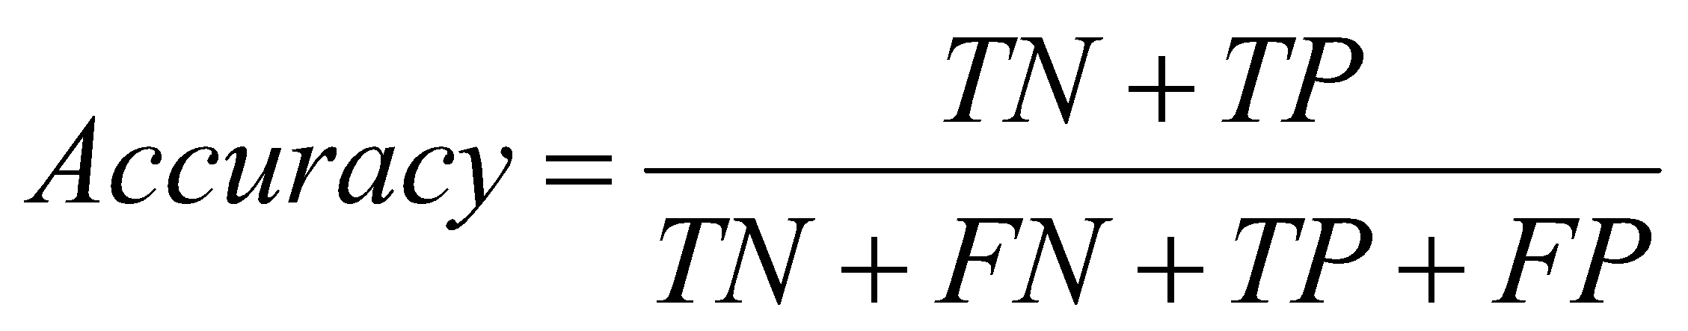
Confusion Matrix
Several standard terms have been defined for the 2 class matrix
The accuracy (AC) is the proportion of the total number of predictions that were correct
Accuracy = 3 / 4 = 75%

Slide 30
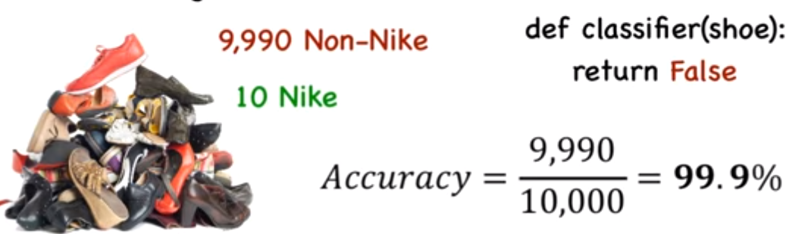
What’s wrong with this?
it may be a poor measure for imbalanced data

Slide 31
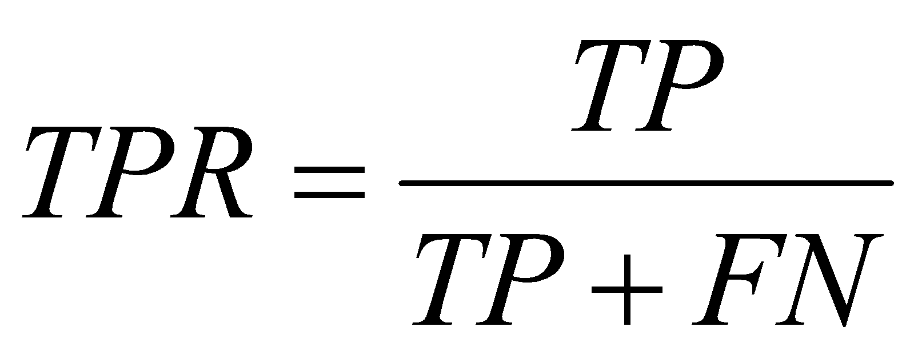
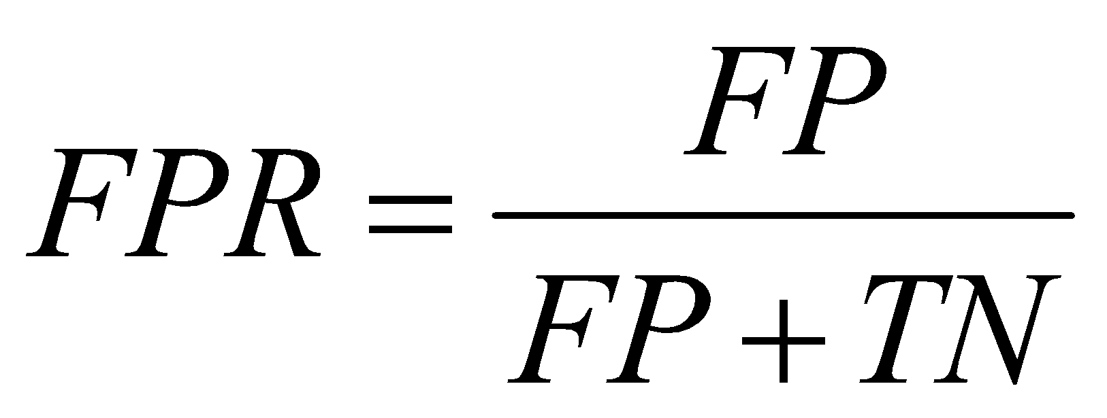
Confusion Matrix
The recall or true positive rate (TPR) is the proportion of positive cases that were correctly identified
True Pos. /# actual pos.
The false positive rate (FPR) is the proportion of negatives cases that were incorrectly classified as positive
TPR or recall = 2 / 3 = 66.7%
FPR = 0 / 1 = 0 %

Slide 32
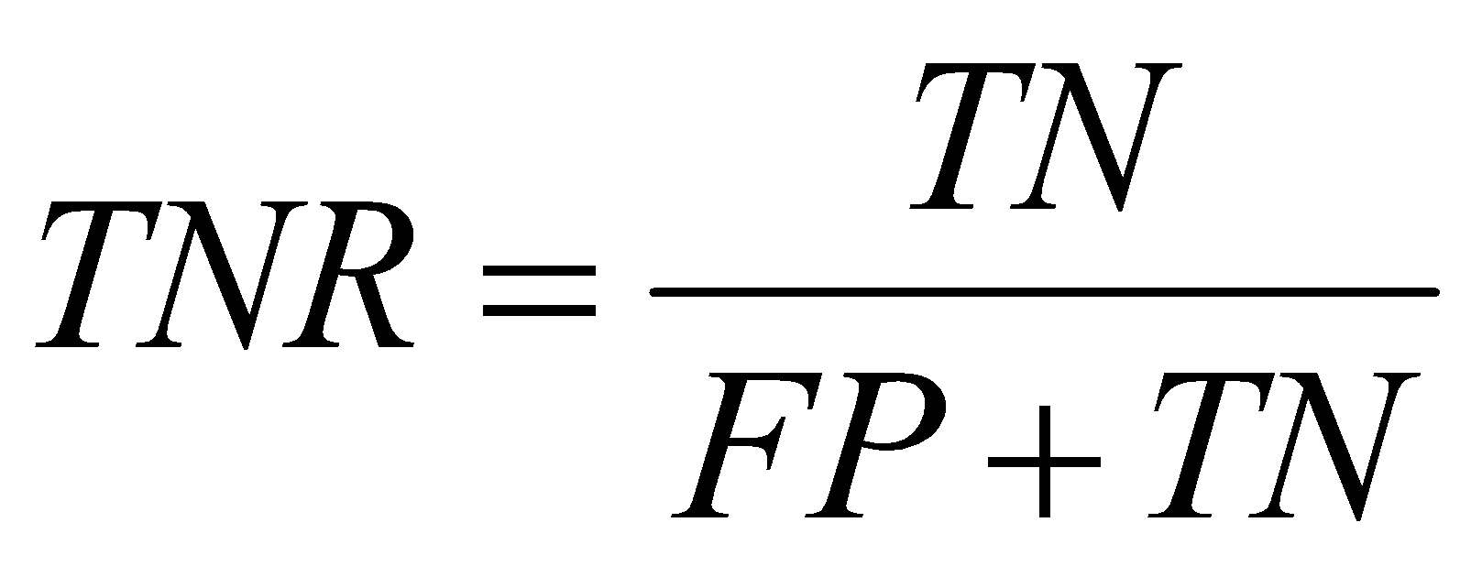
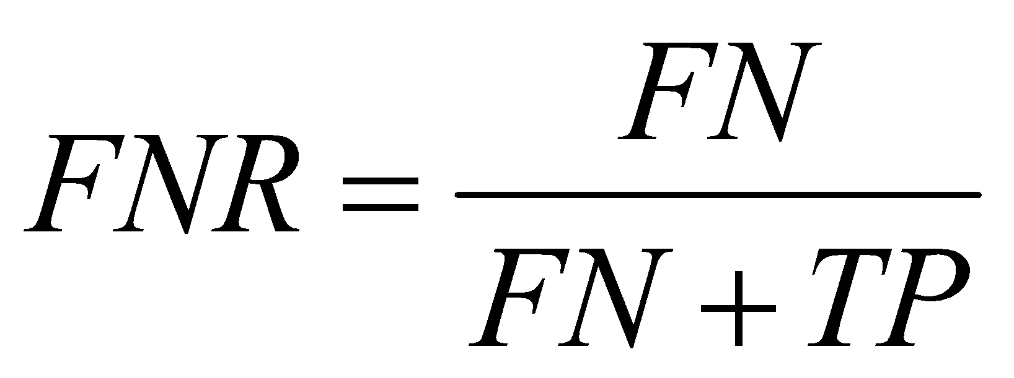
Confusion Matrix
The true negative rate (TNR) is defined as the proportion of negatives cases that were classified correctly,
The false negative rate (FNR) is the proportion of positives cases that were incorrectly classified as negative
TNR = 1 / 1 = 100%
FNR = 1 / 3 = 33.3%

Slide 33
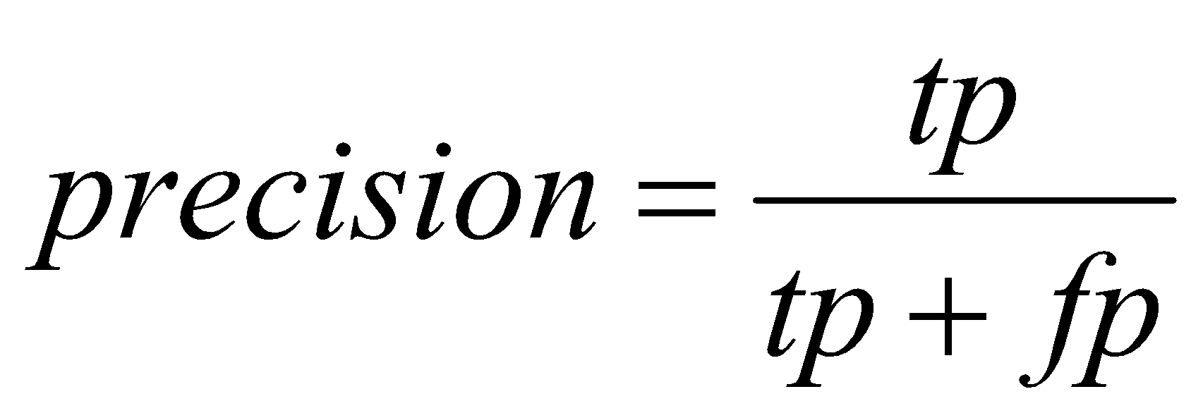

Confusion Matrix
precision (P) is the proportion of the predicted positive cases that were correct
True pos. / # predicted pos.
precision = 2/2 = 100%
F measure is harmonic mean of precision and recall
F1 = (2 * 1 * 0.667)/(1+0.667) = 0.8

Slide 34
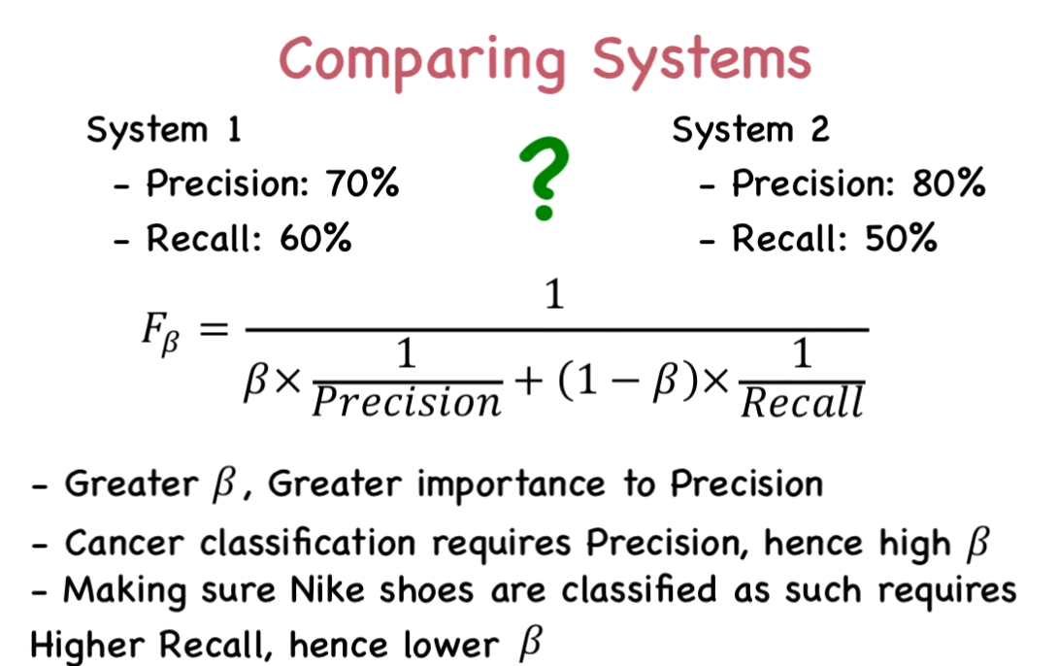
Fbeta Measures

Slide 35
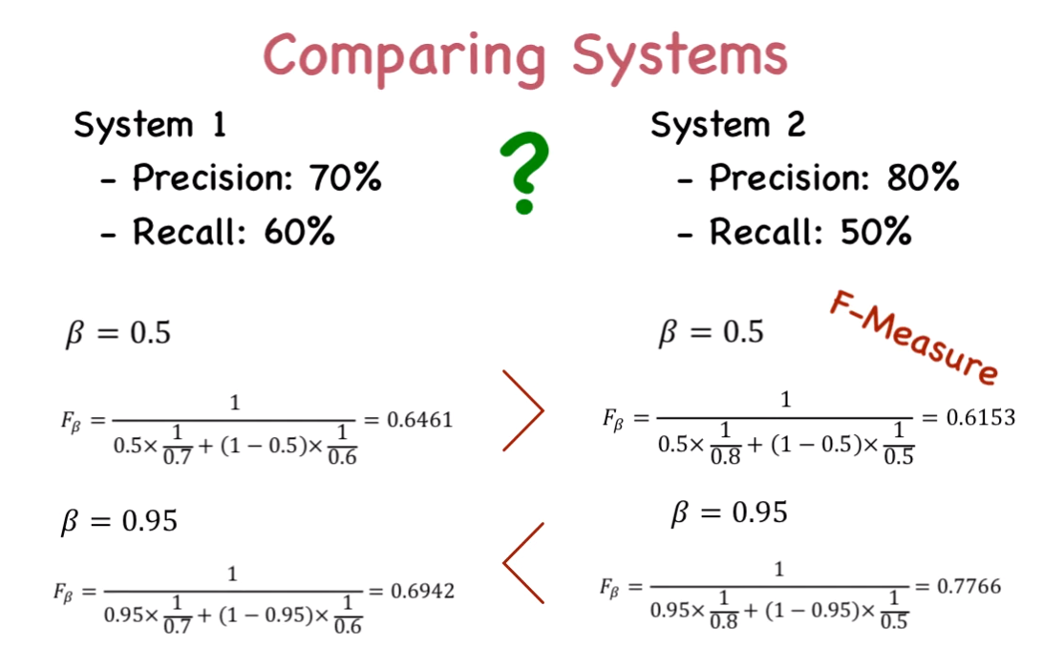

Slide 36
Exercise
 | Actual
Positive | Negative
40 | 9760 | Negative
60 | 140 | Positive
Predicted

Slide 37
References
Introduction to Data Mining by Tan, Steinbach, Kumar (Lecture Slides)
http://robotics.stanford.edu/~ronnyk/glossary.html
http://www.cs.tufts.edu/comp/135/Handouts/introduction-lecture-12-handout.pdf

Slide 38
Questions!

